Slide 1
Lab4 Image classification deep learning

Slide 2
Objective
Understand how to use Pytorch
Build a neural networks model for the classification problem in Pytorch

Slide 3
Pytorch tutorial
https://youtu.be/MrnQ5LgcNBI
https://youtu.be/QAY6sfca6wI
Pytorch version is 0.4 in this tutorial
Official tutorial
https://pytorch.org/tutorials/

Slide 4
Coding detail
Implement the empty part of following files
Lab4.ipynb
You can try to use different model or modify the hyperparameter to get better performance
Advance
Medical image classification is a hot topic.
You can try to search for the deep learning paper in this topic and implement the paper

Slide 5
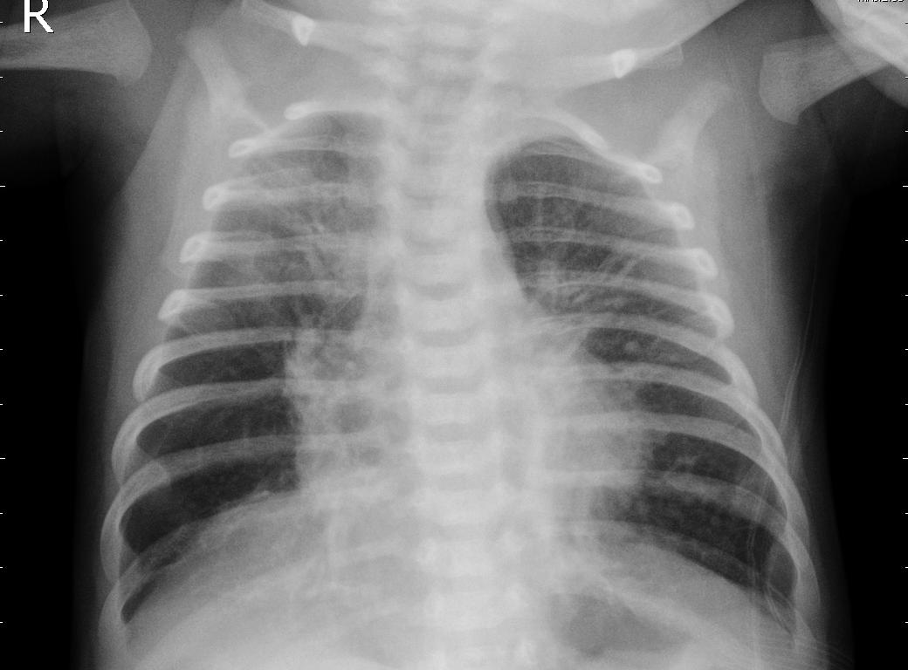
Dataset – Chest-Xray image
Pneumonia
label
INFECTED : 0
NORMAL : 1
Training images: 5286
Testing images: 624
Download data from Kaggle

Slide 6
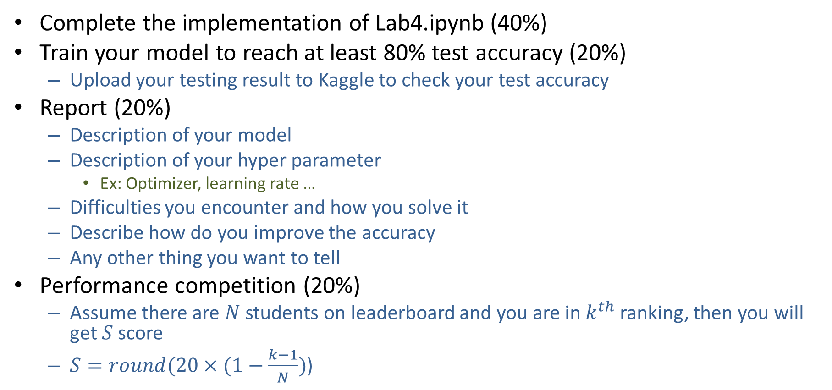
Tasks
Complete the implementation of Lab4.ipynb (40%)
Train your model to reach at least 80% test accuracy (20%)
Upload your testing result to Kaggle to check your test accuracy
Report (20%)
Description of your model
Description of your hyper parameter
Ex: Optimizer, learning rate …
Difficulties you encounter and how you solve it
Describe how do you improve the accuracy
Any other thing you want to tell
Performance competition (20%)
Assume there are $N$ students on leaderboard and you are in $k^{th}$ ranking, then you will get $S$ score
$S=round(20×(1−\frac{k−1}{N})$)

Slide 7
Tasks
Please see Lab4.ipynb for details
Note
You can use pretrained models
You can only use Pytorch in this lab
You can use GPU to run your code
Command in 414 server
$ srun --gres=gpu:1 -uv --x11=first jupyter notebook --ip=0.0.0.0 --no-browser

Slide 8
Join the Kaggle competition
Create Kaggle account first
Competition URL:
https://www.kaggle.com/t/f6c448d41b6c431ab8ab05005ca11f13

Slide 9
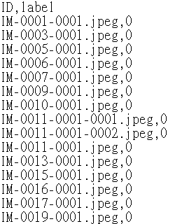
Upload to Kaggle
Write file
Write the prediction to csv file (ID_result.csv)
Two column: ID,label
Evaluation
Categorization accuracy
Upload to Kaggle

Slide 10
Reminder
Submit Deadline : 2 week (05/15/2020 11:59 PM)
You need to submit your code to New E3 and upload the result to Kaggle
Hand in your files to new e3
Your code
Readme.txt
Simply explain how to run your code
StudentID_report.pdf

Slide 11
Notice!!!
Change your team name to your ID
If TA can not find your ID, you will loss 20% of score in this lab directly
You only have 10 times maximum daily submissions

Slide 12
Shut down your kernel !!!!!
Remember to SHUTDOWN the kernel
To release resources for others.

